Slide 1
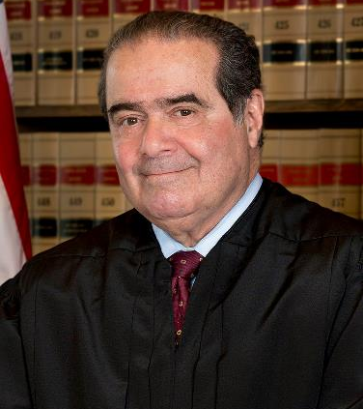
Justice Antonin Scalia’s Life and Impact on the Law
Presented by:
Matthew R. Byrne, Esq.
matthew.r.byrne@gmail.com

Slide 2
What We’ll Cover
Biographical Details
The Constitution: Originalism
Statutes: Textualism and Legislative Intent
Regulations: Chevron
The Structural Constitution
Finding the Right Answer
Disagreements Among Conservatives
Influence on the Judiciary, Lawyers, and Students
Faith and the Judge

Slide 3
Biographical Details
Born 3/11/1936
Italian immigrant background
Georgetown/Harvard
Jones Day – Cleveland
University of Virginia
Positions in Nixon and Ford Administrations
University of Chicago (and Stanford)
  First Federalist Society Faculty Advisor
D.C. Circuit Court of Appeals
Supreme Court – 1986
Died – 2/2016

Slide 4
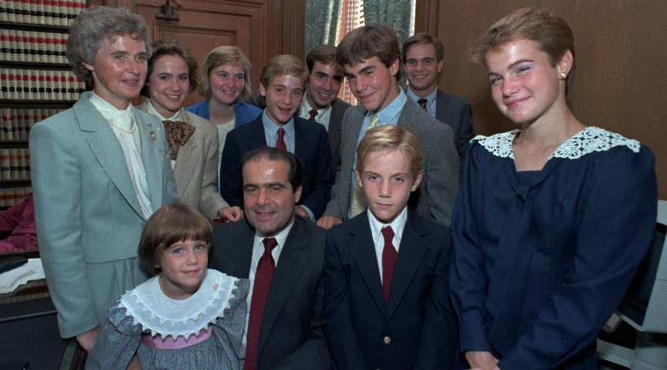
Family Life

Slide 5
Comments on Family Life
To law students:
  “Try to find a practice that enables you to maintain a human existence. . . . [which should include] time for your family, your church or synagogue, community…Boy Scouts, little league.”
To clerks:
  “Be home for dinner. Children are civilized at the dinner table.”

Slide 6
Family Life
Christopher Scalia:
  “It’s true that we’d often discuss law, history and politics. But Dad’s running gags ensured our kitchen would never be mistaken for a salon. Poor conversationalists got it worse than an unprepared lawyer during oral arguments: If anyone said “um,” Dad would leave a chorus of “ummmmmmmms” to spotlight this oratorical shortcoming. Sometimes the umming would spiral into a rendition of ‘Thus Spoke Zarathustra.’”
  “…another of Dad’s favorite pastimes: crumpling his napkin into a ball and throwing it into one of our glasses. Counterattacks were futile, equipped as he was with a narrow wine glass.”

Slide 7
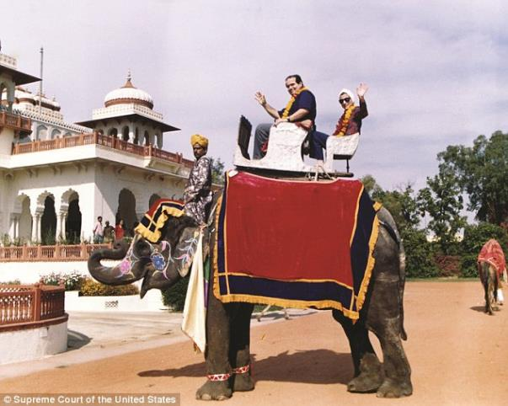
Friendships

Slide 8
The Constitution: Originalism
Rejection of the “Living Constitution”
  “That’s the argument of flexibility and it goes something like this: The Constitution is over 200 years old and societies change. It has to change with society, like a living organism, or it will become brittle and break. But you would have to be an idiot to believe that. The Constitution is not a living organism, it is a legal document. It says something and doesn’t say other things.” (2006 speech to Federalist Society)

Slide 9
The Constitution: Originalism
Rejection of “Strict Constructionism”
  “"I am not a strict constructionist, and no one ought to be . . . . A text should not be construed strictly, and it should not be construed leniently; it should be construed reasonably, to contain all that it fairly means.“ (A Matter of Interpretation)
  “…a degraded form of textualism that brings the whole philosophy into disrepute.” (A Matter of Interpretation)

Slide 10
The Constitution: Originalism
Champion of Originalism:
  "The Constitution that I interpret and apply is not living but dead, or as I prefer to call it, enduring. It means today not what current society, much less the court, thinks it ought to mean, but what it meant when it was adopted.“
  “…whole purpose [of the Constitution] is to prevent change—to embed certain rights in such a manner that future generations cannot readily take them away…”
  Examples: “awful,” “artificial,” and “amusing”
  “Every time the Supreme Court defines another right in the Constitution it reduces the scope of democratic debate.”

Slide 11
The Constitution: Originalism
Examples:
  District of Columbia v. Heller – “well-regulated militia” requires historical meaning
  Kyllo v. United States – warrantless thermal imager – new technology, look at limits on “upon this power of technology to shrink the realm of guaranteed privacy,” looking at what privacy was guaranteed
  Casey v. Planned Parenthood – justices should perform “essentially lawyers’ work,” by “reading text and discerning our society’s traditional understanding of that text.”

Slide 12
Statutes: Legislative Intent
Look at legislative text, not legislative intent:
  Graham County Soil & Water Conserv. Dist. V. U.S. ex rel Wilson – “The Constitution gives legal effect to the ‘laws’ Congress enacts not the objectives its Members aimed to achieve in voting for them.”
Bicameralism and presentment
Law governs, not legislator’s intent or judge’s preference
“It is simply not compatible with democratic theory that laws mean whatever they ought to mean, and that unelected judges decide what that is;” and “[t]his corrosion of democracy occurs even when law-revising judges are elected,” because “[t]he five or seven or nine members of a state supreme court, lawyers all, can hardly be considered a representative assembly.”

Slide 13
Statutes: Legislative Intent
Examples:
  Affordable Care Act
  Title VII
  Role of staff
  Does Senate know House’s intent, and vice versa?
  Does president know intent?
  535 different intents?

Slide 14
Regulations: Chevron
Chevron USA, Inc. v. Natural Resources Defense Council (1984)
  Before Scalia joined the court
  Step 1: Has Congress spoken? Is intent clear?
  Step 2: If silent or ambiguous, defer to administrative agency’s reasonable interpretation
Scalia in 1980s:
  “background rule of law against which Congress can legislate”
  Legislators “do not have to gamble upon whether, if they say nothing about it in the statute, the ultimate answer [to an interpretive question] will be provided by the courts or rather by the Department of Labor.”
Changing view?

Slide 15
Regulations: Auer
Auer v. Robbins (1997)
  Scalia Majority Opinion: “ultimate criterion” in interpreting regulations “is the administrative interpretation, which becomes of controlling weight unless it is plainly erroneous or inconsistent with the regulation…”
But….
Perez v. Mortgage Bankers Association (2015)
  Scalia Concurrence: Supreme Court should abandon Auer!

Slide 16
The Structural Constitution
“Every tinhorn dictator in the world today has a Bill of Rights, every banana republic. The first thing you do when you seize power is to promulgate a bill of rights, and the so-called world community applauds... As long as the real constitution does not prevent centralization of power in one person or in one party you can ignore the bill of rights….The structural cases…That is what’s crucial.”

Slide 17
The Structural Constitution
Morrison v. Olson (1988)
  Dissented (8-1) from decision upholding office nominally part of executive branch
  Case “about power” and about “the allocation of power among Congress, the President and the courts in such fashion as to preserve the equilibrium the Constitution sought to establish…so that a gradual concentration of powers in the same department can effectively be resisted.” (quoting Federalist No. 51)
  Article II and executive power: “[T]his does not mean some of the executive power, but all of the executive power.”

Slide 18
Getting the Right Answer
“Stupid But Constitutional” Stamp
“If I were king, I would not allow people to go about burning the American flag. However, we have a First Amendment, which says that the right of free speech shall not be abridged.”
“If you’re going to be a good and faithful judge, you have to resign yourself to the fact that you’re not always going to like the conclusions you reach. If you like them all the time, you’re probably doing something wrong.”

Slide 19
Disagreements Among Conservatives
Scalia v. Thomas on Fourth Amendment
Scalia decision in Raich case
Scalia and Thomas v. Roberts and Alito (and Kennedy) on Originalism

Slide 20
Influence on the Judiciary, Lawyers, and Students
“His views on textualism and originalism, his views on the role of judges in our society, on the practice of judging, have really transformed the terms of legal debate in this country. He is the justice who has had the most important impact over the years on how we think and talk about law.” – Justice (then Dean) Elena Kagan
“We are all originalists now.” – Ronald Dworkin

Slide 21
Influence on the Judiciary, Lawyers, and Students
Lawyers - ?
Students
  Dissents focus of law school instruction
  Federalist Society

Slide 22
Faith and the Judge
Devout Catholic, but not a “Catholic judge”
Latin Mass
2002 First Things article on the death penalty and the role of a judge
“He was a man of extraordinary legal genius and fidelity to the Constitution…[but] the larger part [of his character] was his enduring Christian character. His life as a husband, father, friend, scholar and judge was shaped profoundly by his Catholic faith. What made him ‘great’ in the only way that finally matters was his moral integrity.” – Archbishop Chaput
2013 New York Magazine Interview

Slide 23
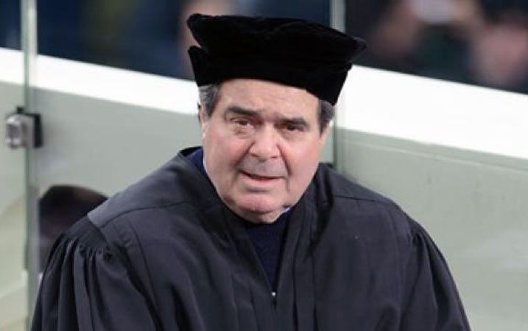
Faith and the Judge

