Slide 1

EARLY VOTING BEGINS APRIL 10. ELECTION DAY IS MAY 8, 2018.

Slide 2
BY THE NUMBERS
Cardholders
494,936
Households
80%
Locations
41
Square Feet
931,809
Employees
840+
Circulation
19.8 million
60% increase

Slide 3

2016 circulation
2nd IN THE
COUNTRY

Slide 4

OUR LIBRARY IS IMPORTANT
Homework help and reading programs
Support for small businesses and the economy
Free programs for residents of all ages

Slide 5


In 2013 we received the National Medal for Museum and Library Service, the nation’'s top honor for museums and libraries.
In 2017 we received our fifth straight Five-Star Library award from Library Journal.

Slide 6
AWARDS
Auditor of State
Certificate of Achievement with Distinction
Duke Energy
PowerPartner
Hamilton County Recycling and Solid Waste District
John Van Volkenburgh Award
Cincinnati Preservation Association
Rehabilitation Award
Ohio Library Council
Library Innovation Award
SWORWIB
Super Outreach Partner
Urban Libraries Council
Top Innovator Awards

Slide 7

LOCAL & STATE
FUNDING COMPARISON
160
140
Millions
120
Other Revenue
100
Local Funding
80
State Funding
60
40
20
0
Hamilton County
Franklin County
Cuyahoga County

Slide 8
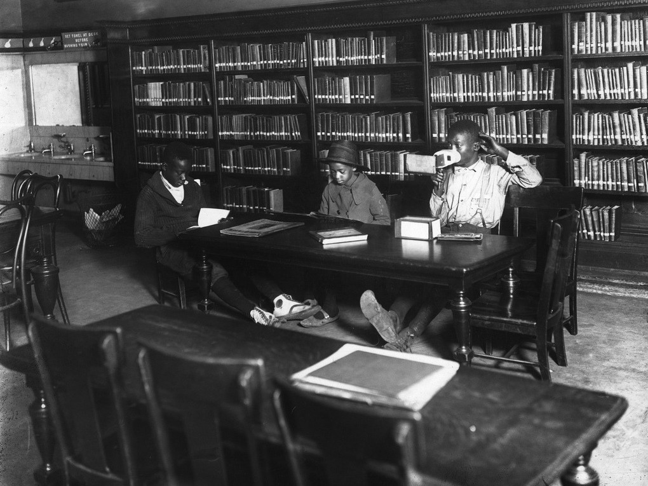
FACILITY NEEDS
7 branches are 100+ years old (2 never renovated)
3 built in 20s-30s (1 never renovated)
10 built in 50s-70s (7 never renovated)

Slide 9
FACILITY NEEDS
Current budget fund $2 million annually
$54 million in system-wide needs
18-month comprehensive review
40+ community meetings

Slide 10

MAY LEVY REQUEST
1-mill to fund operating expenses and capital improvements for a period of 10 years.
Cost is less than $3 a month per $100,000 of property value.

Slide 11
WITH LEVY APPROVAL
Ensure All 41 Locations Well Maintained & Up To Date
ADA Accessibility
Repairs, Replacements
& Renovations
Computers & Digital Materials
Continue Programs & Services
Books & Other Materials

Slide 12
Early voting begins April 10.
Election Day is May 8, 2018.
You can register to vote at the library (deadline is April 9).

