Slide 1
Repeal and Replace: Is it dead?
Grace-Marie Turner, Galen Institute
EmpowerU
March 28, 2017

Slide 2
The Political Landscape
Health Policy Helped Reshape American Politics …
And May Continue to Reshape It

Slide 3
ACA Major Reason For Tectonic Political Shift
Election | White House | Senate | House | State Trifectas
2008 | D | D (60) | D (257) | 17D/10R
2016 | R | R (52) | R (241) | 5D/25R
If GOP gets this wrong, it could happen again

Slide 4
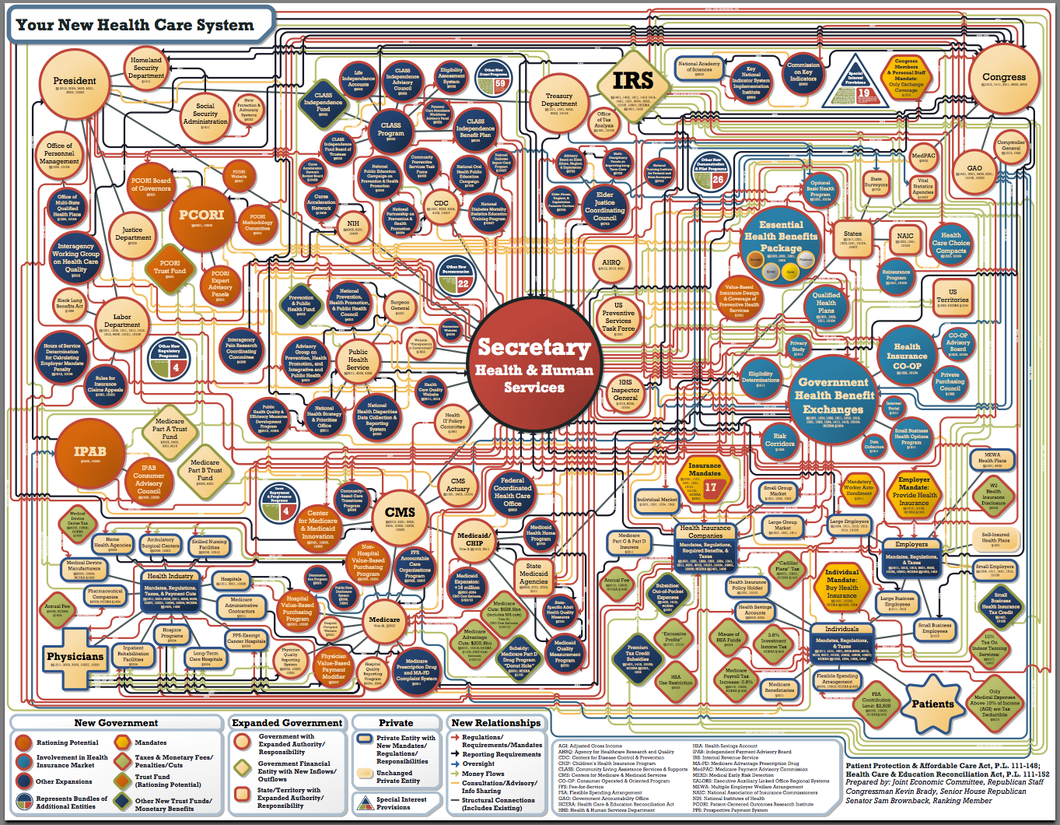

Slide 5
The Market Landscape
How the ACA Affected Individual and Group Markets

Slide 6
How the ACA Affected Coverage Change between December 2013 and September 2016
 | Net Change
Individual Coverage | +6.7 million
Group Coverage
Fully Insured | -8.7 million
Self-insured | +4.8 million
Net Group Change | -3.9 million
Net Private Coverage Change | +2.8 million
Medicaid/CHIP | +13.8 million
Total Change in Coverage | +16.6 million
NOTE: Excludes FEHB, MA and supplemental coverage products, such as dental, vision, Rx and Medigap. Source: Haislmaier and Gonshorowski, “2015 Health Insurance Enrollment,” Heritage Foundation; Haislmaier testimony before House Budget Committee, January 24, 2017. Data on private markets based on Mark Farrah dataset compiled from insurer NAIC filings. Medicaid, which includes CHIP, based on data compiled by CMS and the Kaiser Family Foundation.

Slide 7
Medicaid: Primary Source of Coverage Gains December 2013 – September 2016

Slide 8
Effect of Individual Mandate 2015 Source: IRS

Slide 9
Overview of the congressional process for Repeal and Replace
Impact of the process on policy options

Slide 10
Last Year’s Partial Repeal Bill
January 2016: House and Senate passed – and President Obama vetoed – a partial repeal bill
What it did
Immediately repealed all taxes
Individual mandate (tax on the uninsured)
Employer mandate (tax on firms that don’t sponsor health coverage)
Taxes on drugs, devices, insurance premiums (including the “Cadillac tax”), investment income and tanning beds
Repealed, after a two-year delay, ObamaCare coverage provisions
Tax credits for individuals and small firms (subsidies)
Medicaid expansion continued but federal payments were reduced

Slide 11
ObamaCare is collapsing

Slide 12
2017 “Replace” Legislation

Slide 14
What was in the 2017 Replace bill?
Repealed all of the ACA taxes (except delay in the Cadillac Tax)
Zeroed out the tax penalties for the individual and employer mandates
Protected people currently on coverage
Preserved Medicaid expansion ****
Included tax credits to provide targeted help for un- and newly-insured
Targeted some of the ACA’s cost-inflating regulations
Allowed states to adjust age rating to 5:1
Allowed tax credits to be used off exchanges

Slide 15
Replace bill also included…
HSA expansion
Less federal regulation, more state oversight plus money to states to stabilize their individual market (including high-risk pools)
More flexibility in benefit design
Age-adjusted tax credits (with income cap)***
“Continuous coverage” requirement instead of “individual mandate”
Medicaid modernization
States choose between keeping expansion in exchange for per-capita allocations in the future or receiving a block grant

Slide 16
CBO says…
The American Health Care Act would have (over 10 years):
cut federal spending by $1.2 trillion (including -$880 billion in Medicaid spending)
cut taxes by nearly $900 billion
Reduce the federal budget deficit by $337 billion

Slide 17
But CBO ascribes magical powers to the individual mandate…
2017: Number of uninsured increases by 4 million
2 million Medicaid beneficiaries who pay nothing for their coverage drop it
1 million people drop their coverage in the exchanges
1 million with job-based coverage drop out
2018: 14 million more uninsured.
5 million will abandon Medicaid
2 million will drop their employer-sponsored coverage
6 million will leave the exchanges
CBO says they don’t lose coverage because of the new bill but because they are no longer forced to buy insurance since the individual mandate penalty is repealed

Slide 18
The 2017 effort
Republicans were trying to repeal as many of the ACA provisions as possible through the budget reconciliation process
Bills considered under that process can be passed by a simple majority and cannot be filibustered in the Senate. BUT …
The rules governing a budget reconciliation bill are very strict
The bill can include provisions that directly change federal spending and revenues
It cannot include provisions whose budgetary effects are “merely incidental to the non-budgetary components of the provision”
The House wanted to send the Senate a bill ready for them to approve

Slide 19
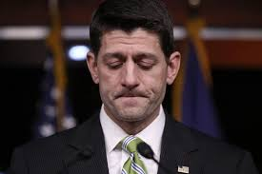
What ‘s next?

Slide 20
Role of the States

Slide 21
States are looking at opportunities
HHS is anxious to approve waivers giving states more flexibility with Medicaid
HHS is encouraging states to use a provision of existing law, “State Innovation Waivers,” to reform their health insurance markets

Slide 22
An immediate risk
States that so far have held back could decide to expand Medicaid
Many felt the House bill had penalized them financially for not expanding Medicaid

Slide 23
Key players and their likely actions

Slide 24
Republican three-prong plan
Regulatory action First HHS rule to stabilize the market, finalized in April
Shortens the 2018 annual open enrollment period
Expands verification of eligibility for subsidies
Allows insurers to collect back premiums before re-enrollment
Provides states new flexibility on network adequacy
Some legislative repeal action still possible
Regular order bills that could get 60 Senate votes. First up:
Competitive Health Insurance Reform Act (H.R. 372) to eliminate anti-trust protections for insurers
Small Business Health Fairness Act (H.R. 1101) allowing small businesses to pool together to try to lower health insurance costs. (Hope to get some Democrats to vote yes)

Slide 25
HHS and White House executive actions

Slide 26
President Trump’s Executive Order
The EO, issued January 20, directs the HHS Secretary to:
“…exercise all authority and discretion available to them to waive, defer, grant exemptions from, or delay the implementation of any provision or requirement of the Act that would impose a fiscal burden on any State or a cost, fee, tax, penalty, or regulatory burden on individuals, families, healthcare providers, health insurers, patients, recipients of healthcare services, purchasers of health insurance, or makers of medical devices, products, or medications.”

Slide 27
How HHS Can Use That Authority
The phrases “the Secretary shall” and “the Secretary may” occur 1,400 times in the text of the ACA
The Obama administration made liberal use of this authority.
The Galen Institute has identified 43 provisions of law that the Obama administration either waived, delayed or ignored
These administrative actions affected everything from individual and corporate mandates, to cost-sharing provisions, to premium stabilization and to waivers for non-compliant plans
The Trump administration may prove as aggressive in using its authorities to dismantle the ACA as its predecessor was in erecting it

Slide 28
Grace-Marie Turner
Galen Institute
703-299-8900
gracemarie@galen.org
twitter.com/GalenInstitute
facebook.com/GalenInstitute
@gracemarietweet
Subscribe to our free email alerts at
www.ObamaCareWatch.org

